Slide 1

Useless Box
Final presentation

Slide 2
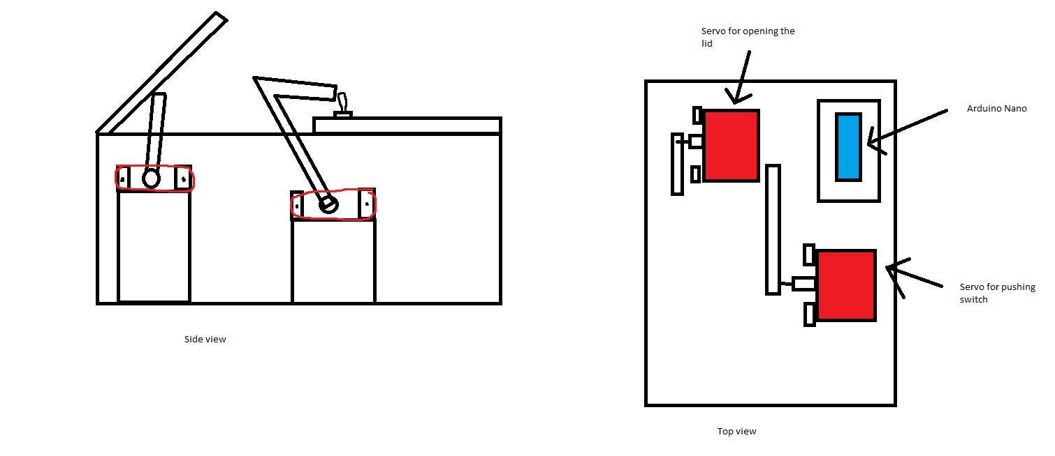
Useless Box Preliminary Sketch
User pushes the toggle switch
Arduino senses the push. Lid opens and finger
emerges to push the switch off.
There is some variation in the way the finger
emerges from inside the box to push the switch
Parts needed: Box, arduino nano, servos, switch, resistor, power source, wires.

Slide 3
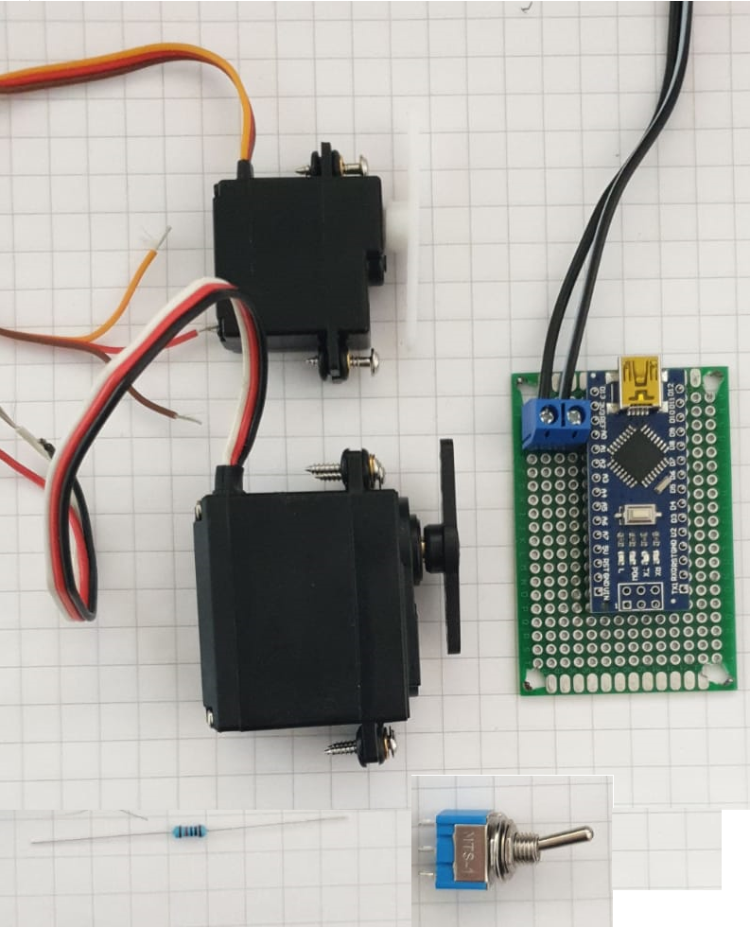
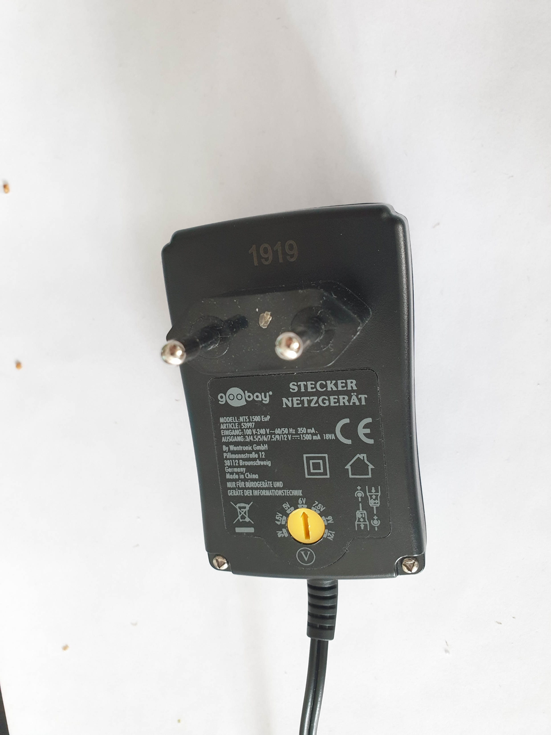
Final bill of materials
Arduino nano
6v Voltage source
Powerful digital servo
Less powerful analog servo
Toggle on-on switch
1k resistor
Circuit board
Wire port
Wires
screws

Slide 4
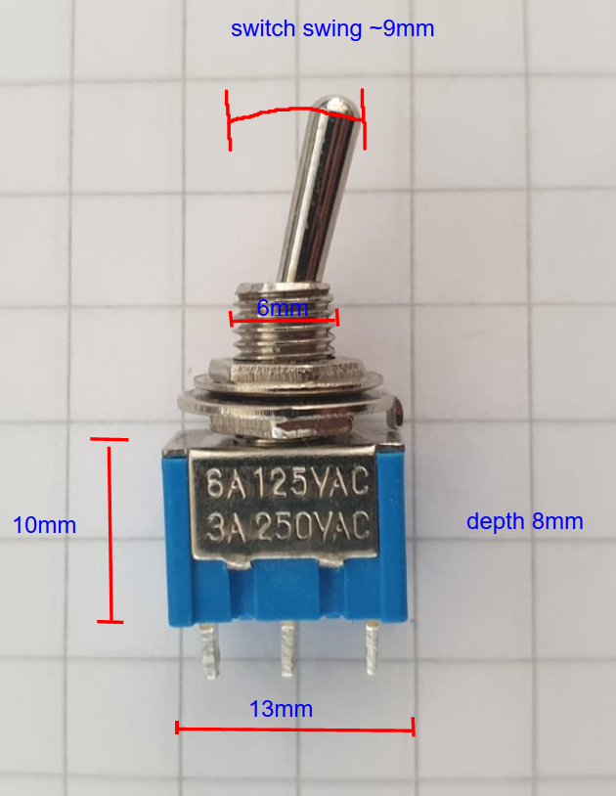
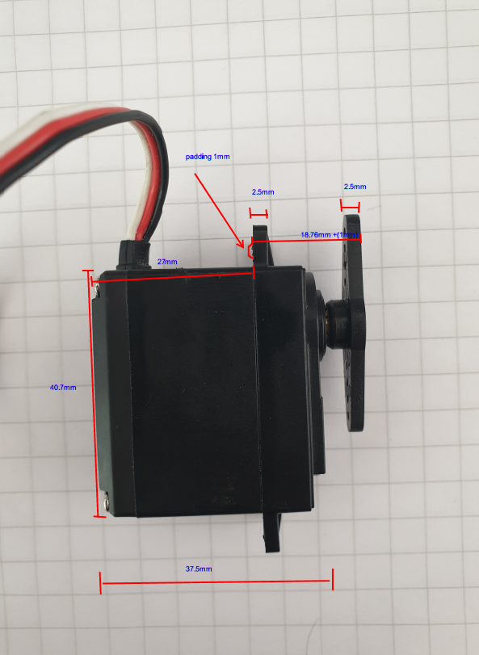
1st Step Measuring the components

Slide 5
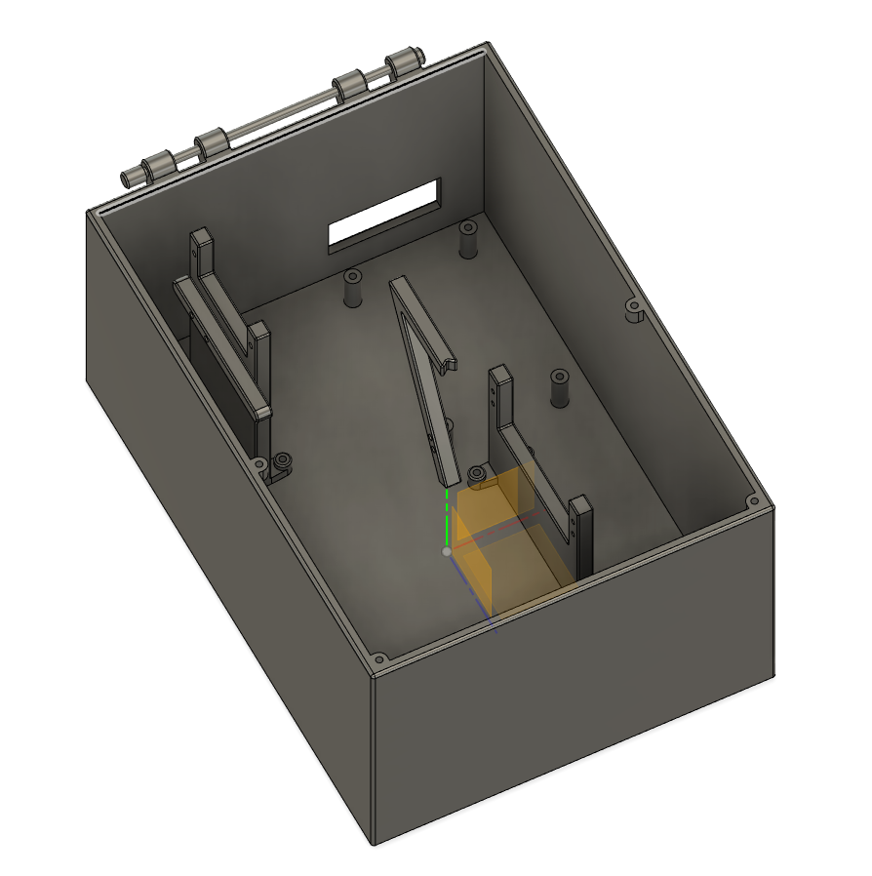
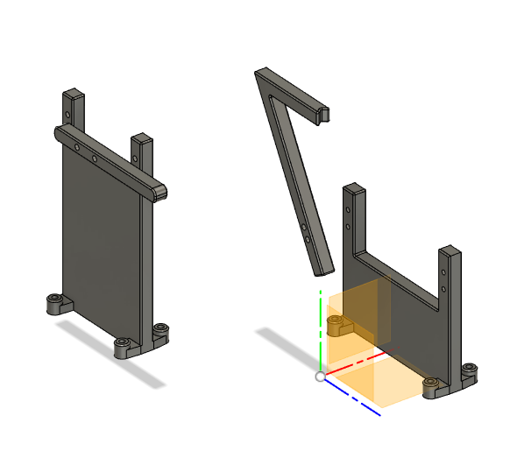
2nd Step Designing the box with Fusion 360

Slide 6
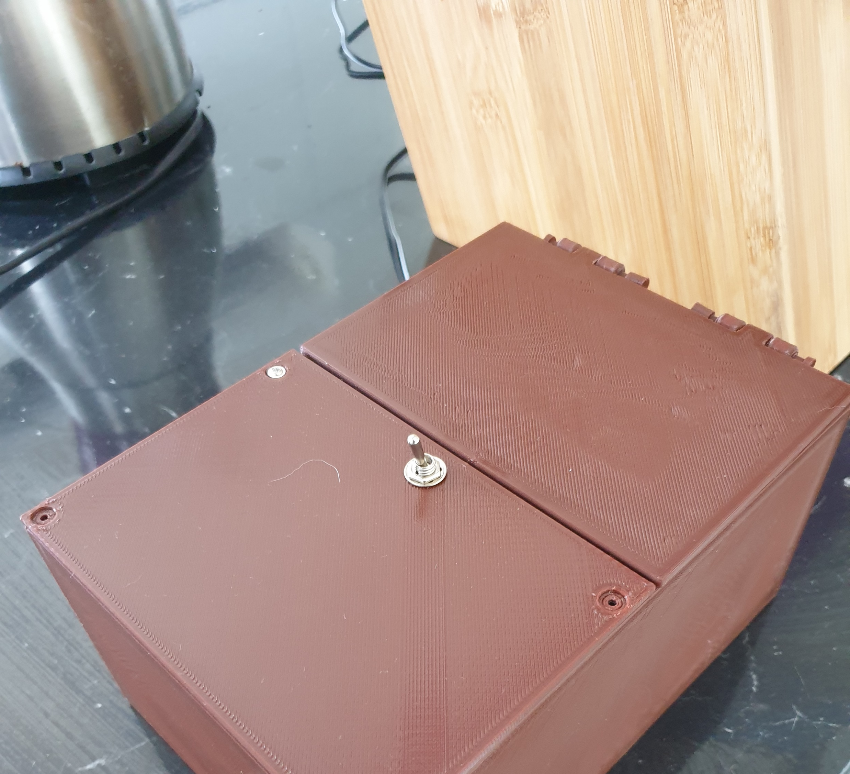
3rd Step 3D printing

Slide 7
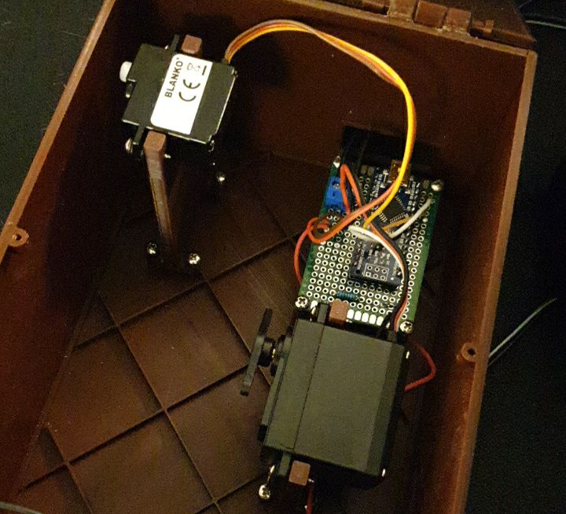
4th Step Wiring and assembling the box

Slide 8
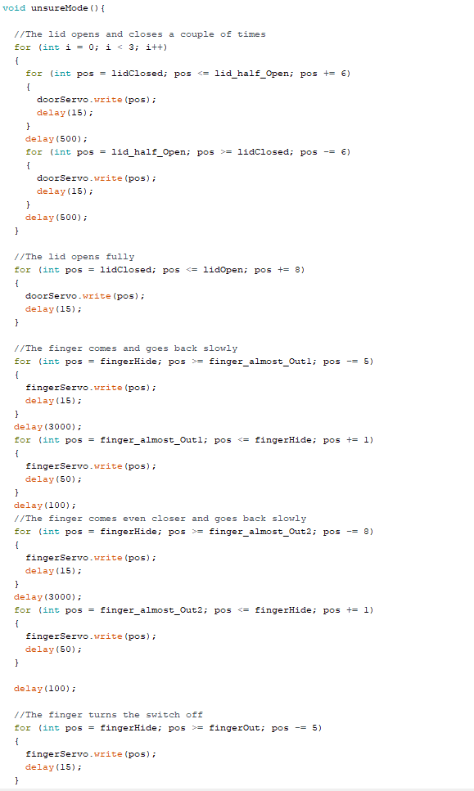
5th Step Programming and calibration
https://youtu.be/J71nf_-gZbA

Slide 9
Lessons learned
Do not use screws if not necessary.
Think more about the assembling part. For example how easy it is to fit screw drivers inside tight spaces.
Actuators that draw lot of current might need special batteries.
Do not try to 3D-print large objects in one go if not necessary.
Surprisingly powerful servo is needed to turn a stiff switch.
3D-printing is very slow. So make your parts as thin/narrow as possible when you can.
and do not make them narrow if it could create a problem (switch finger).

